Slide 1


Funding in Startups: A Data-Driven Insight into Sectors and Regions
This presentation will provide a detailed analysis of startup funding trends, uncovering strategic insights for investors and entrepreneurs. By examining data from multiple sectors, markets, and regions, we will understand which areas receive the most funding and why, offering recommendations to optimize future startup funding strategies.
by Gopal Bagaswar

Slide 2

Introduction to the Project
1
Objective
2
Data Sources
3
Goal
Analyze startup funding trends to uncover strategic insights for investors and entrepreneurs.
Startup funding data from multiple categories, markets, and regions.
Understand which sectors and regions receive the most funding and why and offer recommendations for optimizing future startup funding strategies.

Slide 3

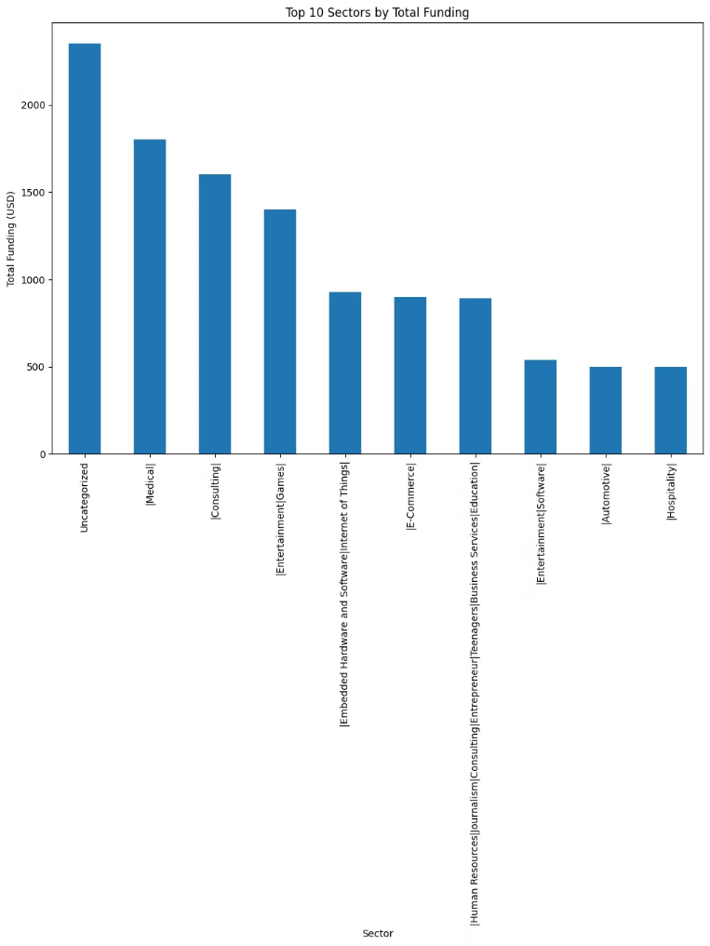
Key Findings – Sectors Receiving the Most Funding
Top-Funded Sectors
- Uncategorized: Highest funding, likely due to startups not fitting into standard categories.
- Medical: Significant funding driven by healthcare innovation.
- Consulting: High funding due to demand for advisory services.
- Games: Strong funding reflecting growth in the gaming industry.
- IoT: Continued high funding due to cross-industry applications.
Emerging Sectors
E-Commerce: Growth supported by expanding online retail.
- Education: Increased funding driven by demand for digital learning.
- Software & Automotive: Steady growth fueled by ongoing innovations.

Slide 4
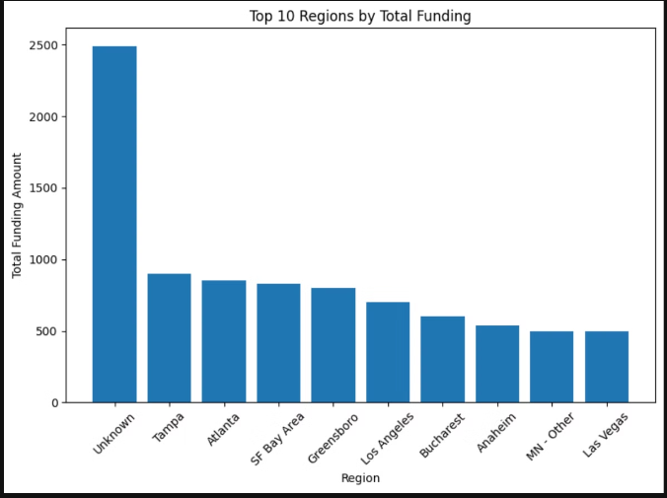

Key Findings – Regions Receiving the Most Funding
Top-Funded Regions
Emerging Regions
Regional Gaps
Tampa and Atlanta:Tampa and Atlanta continue to lead, driven by their strong venture capital ecosystems and a thriving entrepreneurial culture.
Regions like Tampa and Las Vegas are becoming more attractive to investors. These cities are drawing attention as less competitive yet rapidly growing ecosystems, offering new opportunities for investment.
Greensboro and Fort Wayne are struggling with weaker startup ecosystems. Limited access to capital in these areas contributes to their slower growth compared to more established or emerging regions.
Los Angeles also ranks highly due to its significant investments in technology, entertainment, and media.

Slide 5
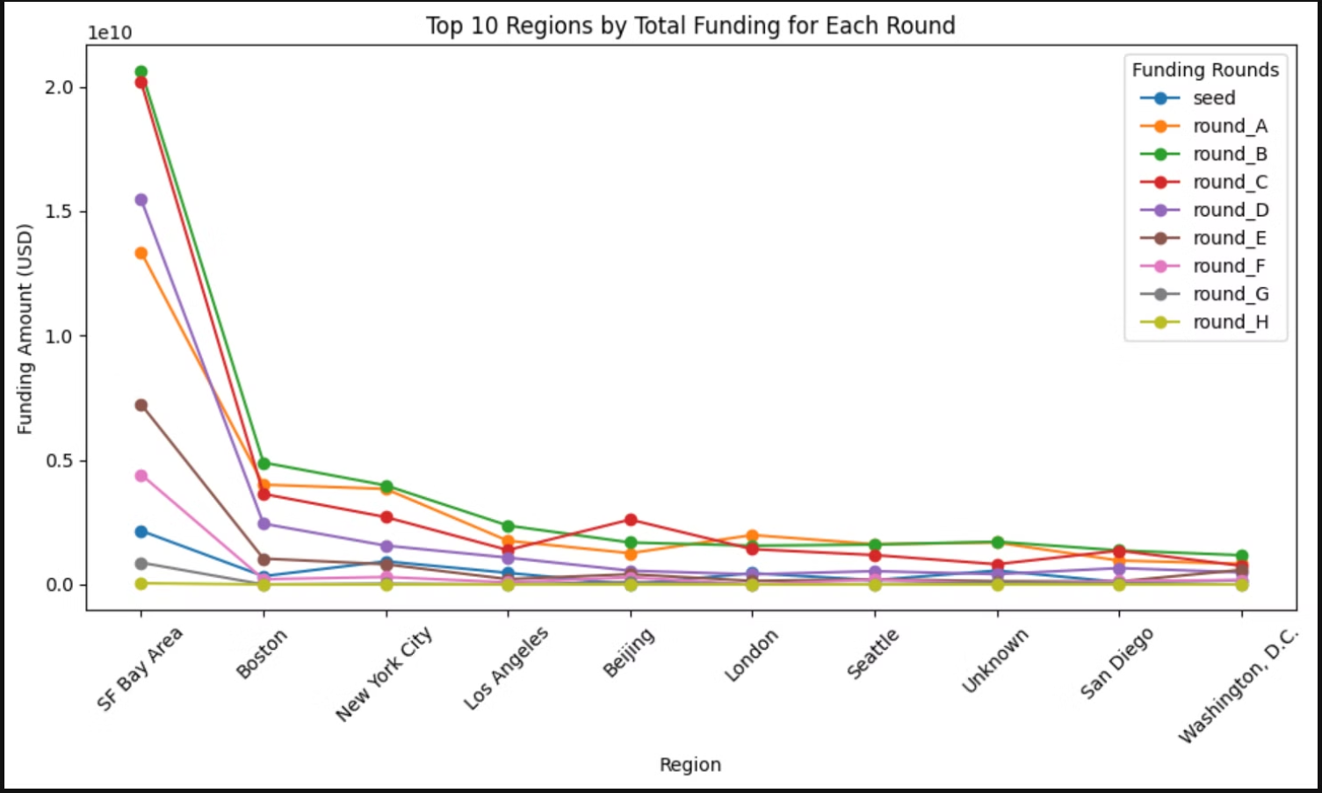
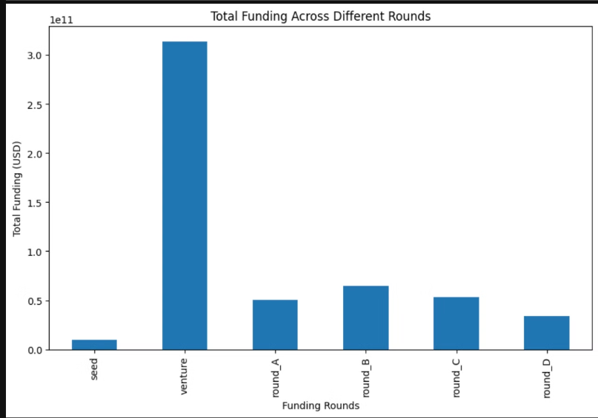
Characteristics Associated with Higher Funding
Sector Influence
3
Geographical Influence
1
Funding Rounds
2
Regions like North America receive the largest amount of Seed and Series A funding, giving them a competitive edge. Strong ecosystems with easier access to capital, such as those in North America, help foster rapid growth across multiple funding stages.
Companies securing significant Seed funding are more likely to move into higher funding rounds, such as Series A and Series B. In regions like North America and Asia, Seed funding is dominant, creating a foundation for progression through subsequent rounds.
Technology and finance sectors, particularly in regions like North America and Asia, attract larger funding amounts due to their scalability and innovation potential. Sectors requiring longer development, like medical or industrial fields, may not experience the same upward trend in advanced funding rounds.

Slide 6
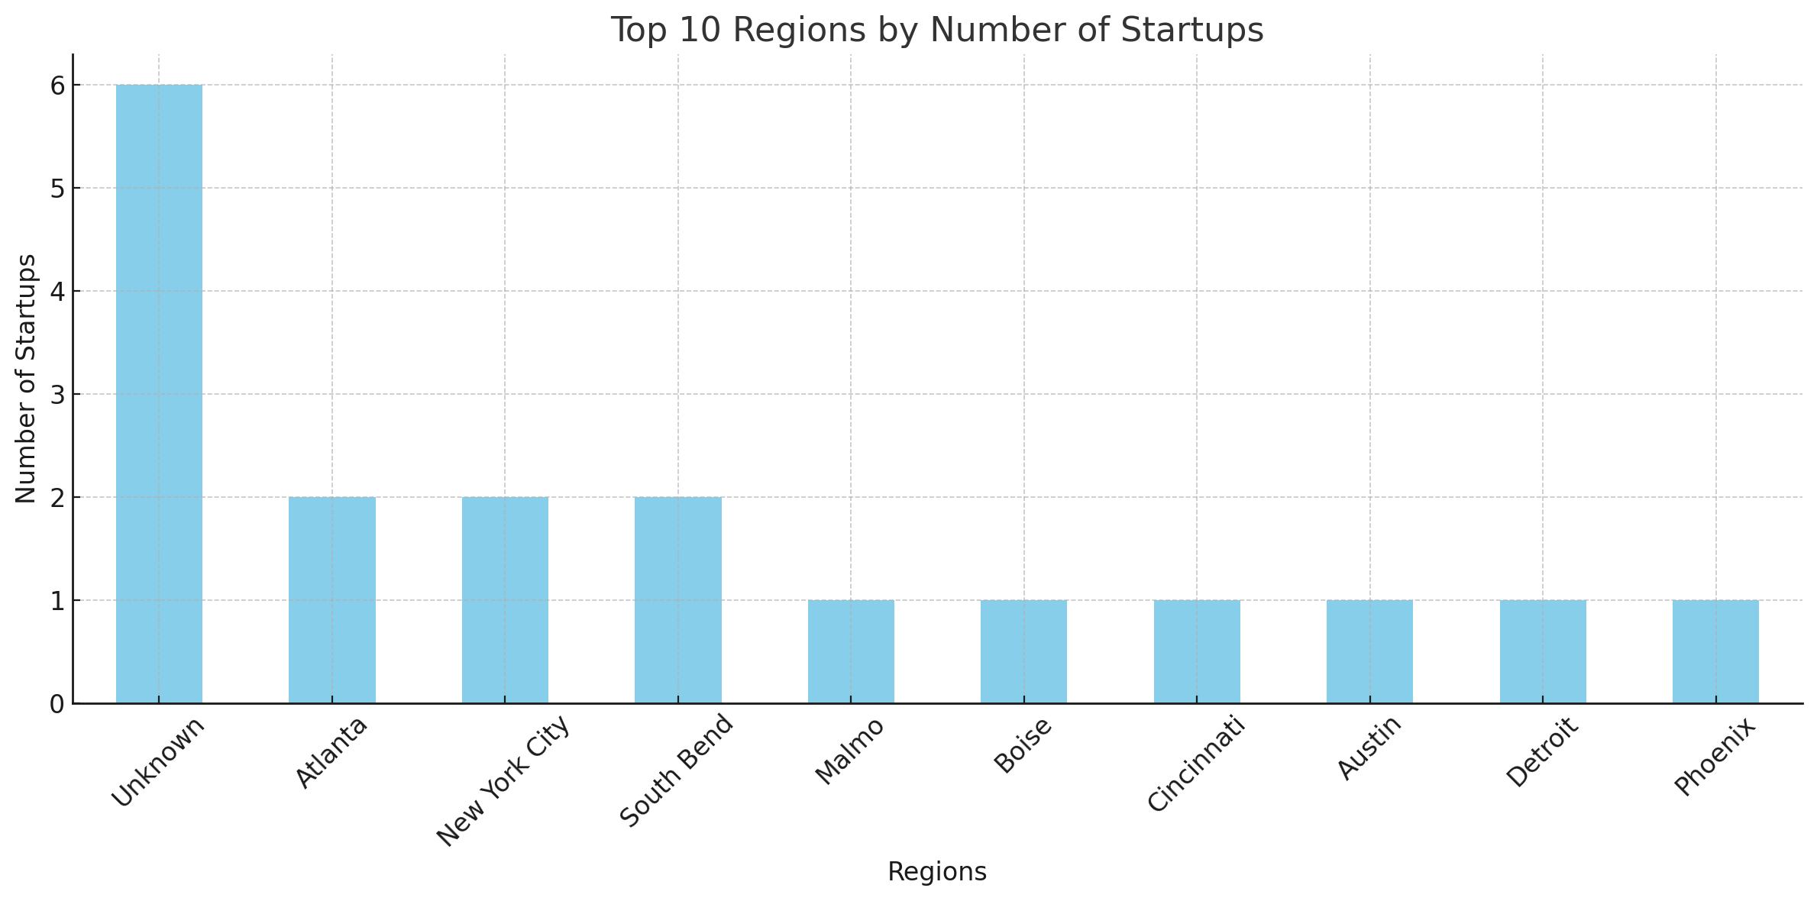
Key Insight: Top 10 Regions by Number of Startups
The leading category is Unknown, indicating possible gaps in data or startups that are not yet associated with a specific region.
Atlanta and New York City are among the top regions, showcasing their strong startup ecosystems and attractive environments for new businesses.
Other notable regions include San Francisco, Los Angeles, and London, though they have fewer startups compared to the leading categories.

Slide 7
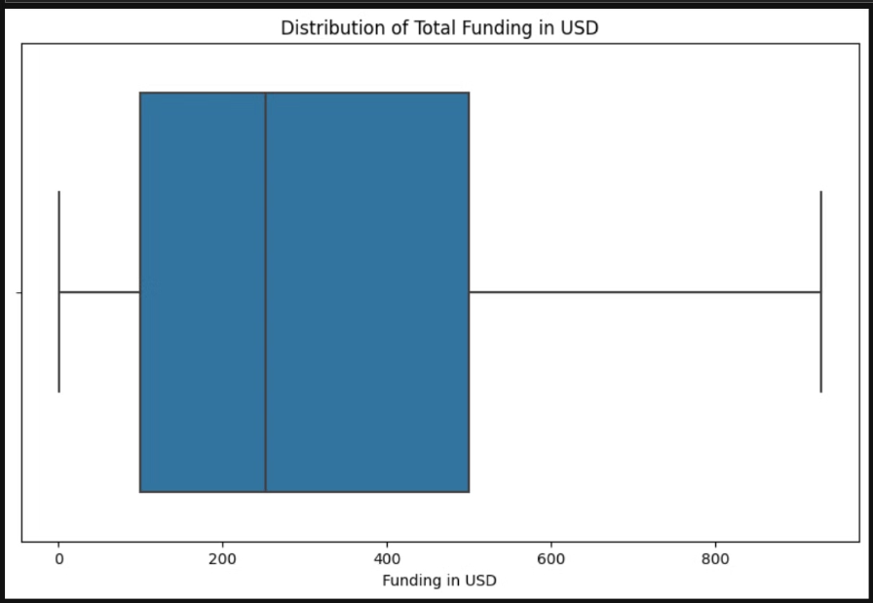
Statistical Analysis – ANOVA Results
ANOVA Test for Sectors
ANOVA Test for Regions
Conclusion
F-statistic: 0.95, p-value: 0.54 → No significant difference in average funding across sectors.
F-statistic: 0.48, p-value: 0.93 → No significant difference in average funding across regions.
Though certain sectors and regions receive more funding, the distribution of funds is statistically even across them.

Slide 8
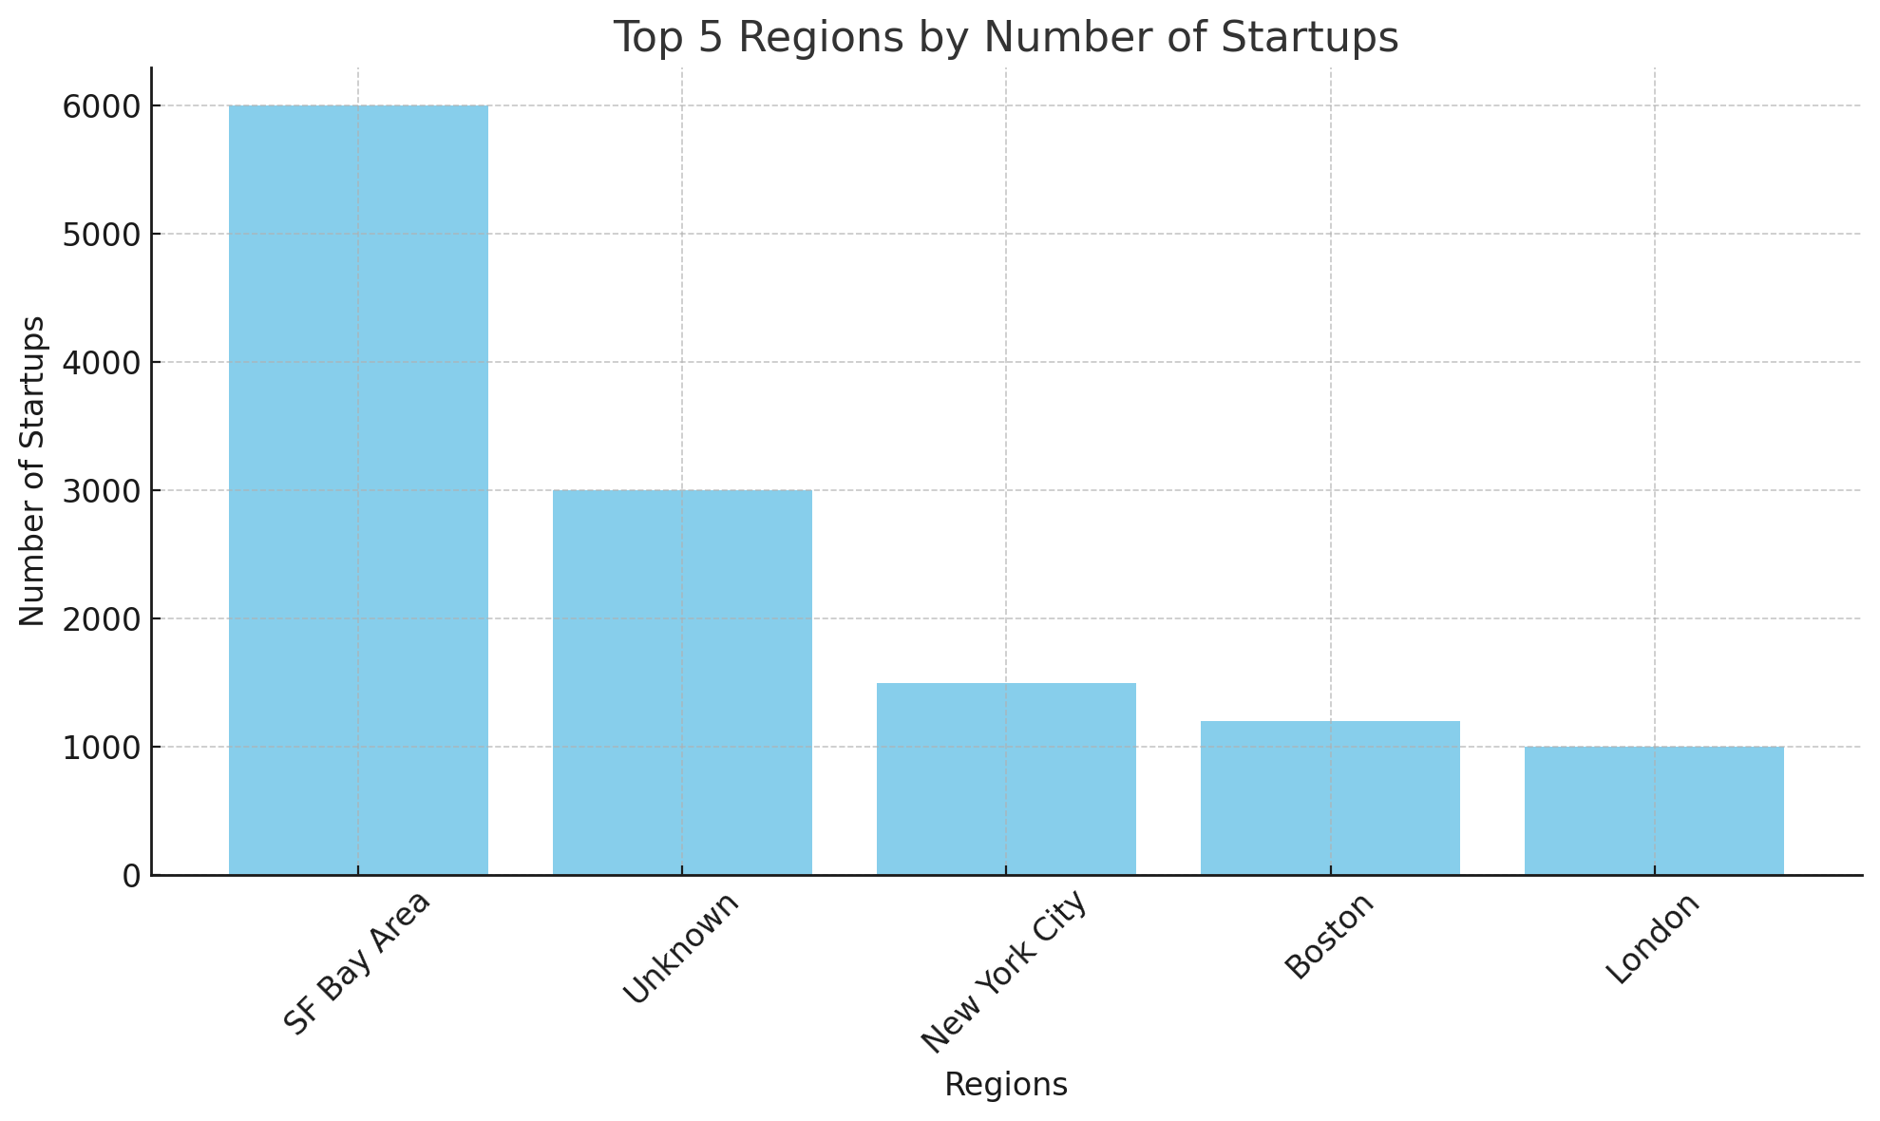
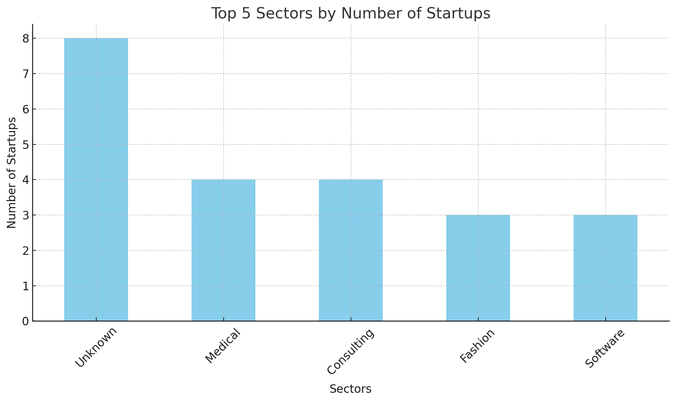
Recommendations for Startups
1
Target High-Growth Sectors
- Focus on innovation in Consulting, Medical, and Software sectors.
- Leverage the increasing presence of startups in these areas
to gain a competitive edge.
2
Optimize Funding Rounds
Secure Seed funding early to build investor confidence.
- Align fundraising with significant milestones like product launches.
3
Diversify Funding Sources
Explore crowdfunding, angel investors, and government grants to broaden the financial base.

Slide 9
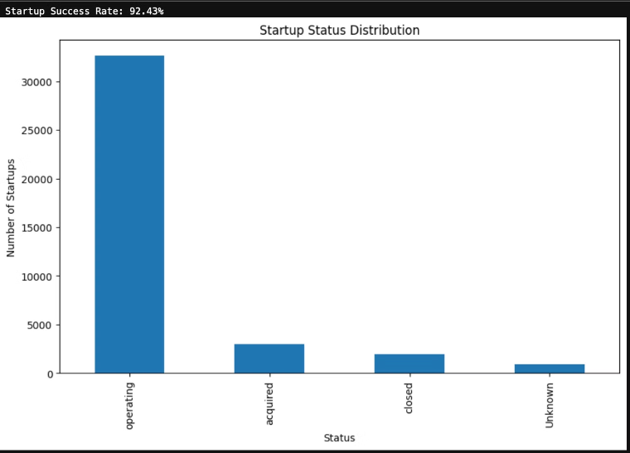




Recommendations for Investors
Consulting
Operating Startups
Invest in Consulting for long-term growth.
Invest in startups that are currently operating, as they represent the majority of successful venture
Medical and Software
Geographical Diversification
- Explore investments in the Medical and Software sectors,
which show a strong presence and growth potential.
Explore emerging regions like Tampa and Las Vegas for higher returns with less competition.

Slide 10
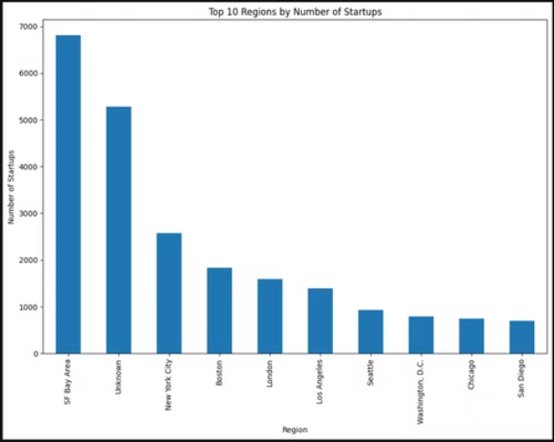
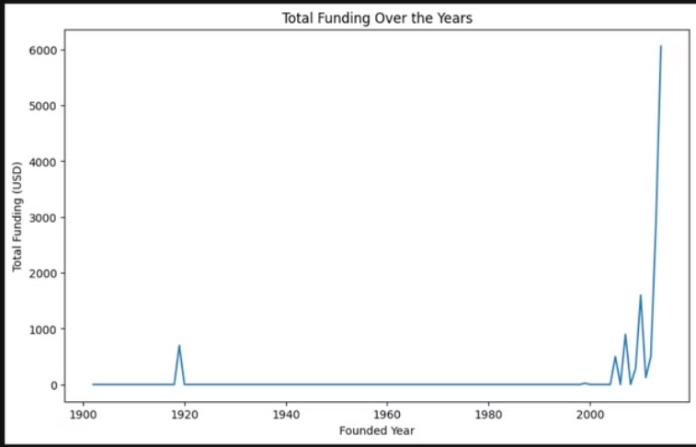
Some More Insights…

Slide 11
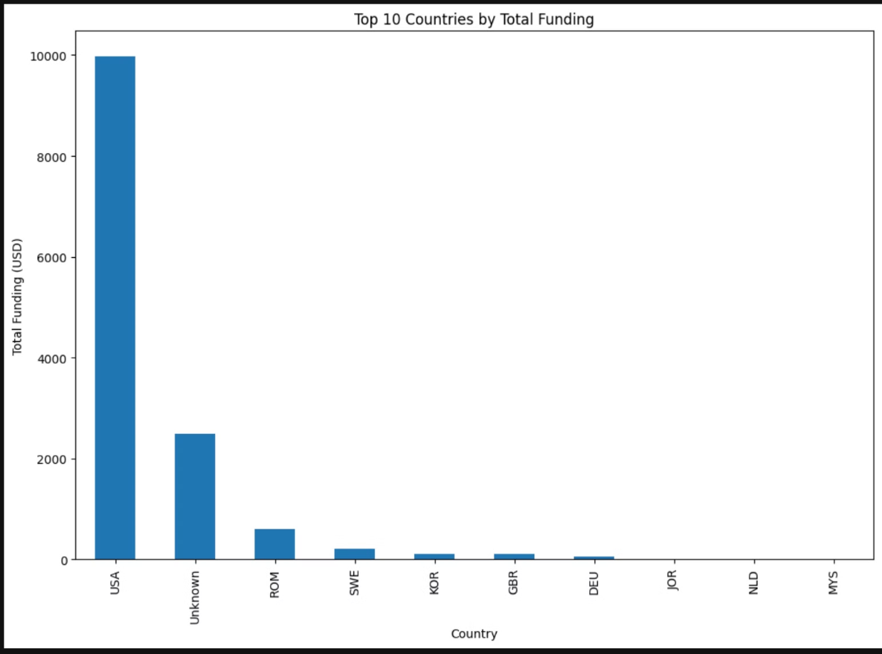

Slide 12




Conclusion
Sectoral Focus
Innovate in high-growth sectors like IoT, Technology, and Consulting.
Regional Diversification
Investors should explore opportunities beyond established hubs to identify high-potential startups early.
Call to Action
Encourage both startups and investors to take a data-driven approach in their strategic decisions to maximize growth and funding potential.

